Slide 1
Introduction AI solution for creating fire detection System. Using smart cameras, you can identify various suspicious incidents such as collisions, medical emergencies, and fires. Of such, fire is the most dangerous abnormal occurrence, because failure to control it at an early stage can lead to huge disasters, leading to human, ecological and economic losses.
fire detection SYSTEM:
Ai Solution

Slide 2




Data Science Component
Collection
Cleaning
Conversion
We are going to use an image dataset for training fire and frame detection. We will implement and see its output and limitations and create a customized model. To balance the efficiency and accuracy, the model would be created to fine-tune the nature of the target problem and fire data.

Slide 3

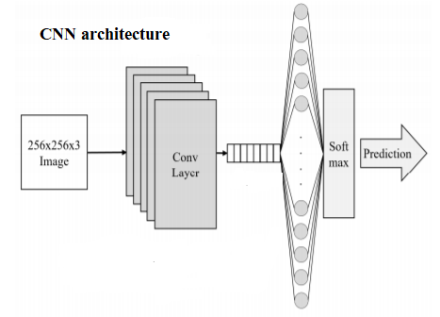
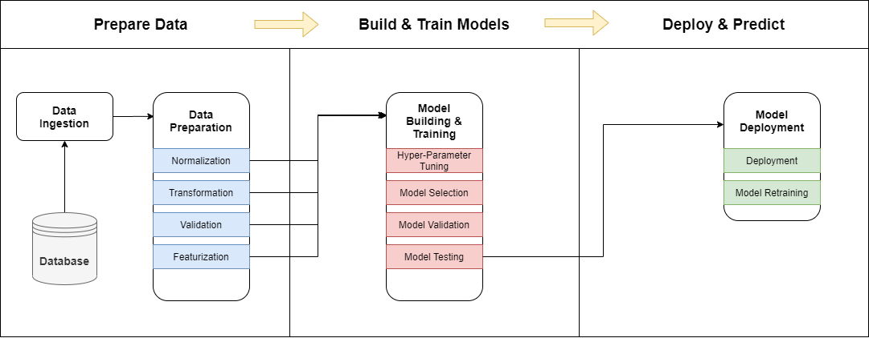
Machine Learning Component
We will train a Deep Learning model for Detection of fire using Python. We will use the TensorFlow, InceptionV3 model from the KERAS API and KERAS library in Python. Inceptionv3 is a convolutional neural network for assisting in image analysis. Inception helps classification of objects in the world of computer vision.

Slide 4
Conclusion
Inspired by the great potential of Convolutional neural networks (CNNs), we can detect fire from images or videos at an early stage. Considering the fair fire detection accuracy of the CNN model, it can be of assistance to disaster management teams in managing fire disasters on time, thus preventing huge losses.

Slide 5
Team Name: Fire Rescuers Product Name: Fire Detection System
Name | Student_Id | Email
Anurag Sharma (Tech Lead) | 100799864 | anurag.sharma2@dcmail.ca
Gbemisola Banjoko | 100766479 | gbemisolabolu.banjoko@dcmail.ca
Kartik Jagdish Sojitra | 100723768 | kartikjagdish.sojitra@dcmail.ca
Ramon Vilarins | 100793713 | ramon.vilarins@dcmail.ca

